Slide 1
Mathematical Modeling Shows that Gln3 Affects the Dynamics of the Gene Regulatory Network Controlling the Cold Shock Response in Saccharomyces cerevisiae
Tessa A. Morris, Kristen M. Horstmann, Brandon Klein, Ben G. Fitzpatrick, Kam D. Dahlquist
Departments of Biology and Mathematics
Loyola Marymount University
Undergraduate Research Symposium
March 19, 2016
Notes:
Change background to be white and can have the background / title text be in color
Dr. D has template that other people have been using

Slide 2
Outline
Yeast Respond to Cold Shock by Changing Gene Expression.
Microarray Data was Generated for Yeast Under Cold Shock Conditions.
A Family of Related Networks Was Generated from the YEASTRACT Database.
The Dynamics of Each Gene in the Network was Modeled Using Ordinary Differential Equations.
L-curve Analysis Was Performed to Determine the Best α.
The Family of Related Network Were Compared to Determine Which Size Network Models the Experimental Data Best.
Notes:
Read whole slide
Change to sentence case.
Change alpha

Slide 3
Outline
Yeast Respond to Cold Shock by Changing Gene Expression.
Microarray Data was Generated for Yeast Under Cold Shock Conditions.
A Family of Related Networks Was Generated from the YEASTRACT Database.
The Dynamics of Each Gene in the Network was Modeled Using Ordinary Differential Equations.
L-curve Analysis Was Performed to Determine the Best α.
The Family of Related Network Were Compared to Determine Which Size Network Models the Experimental Data Best.

Slide 4
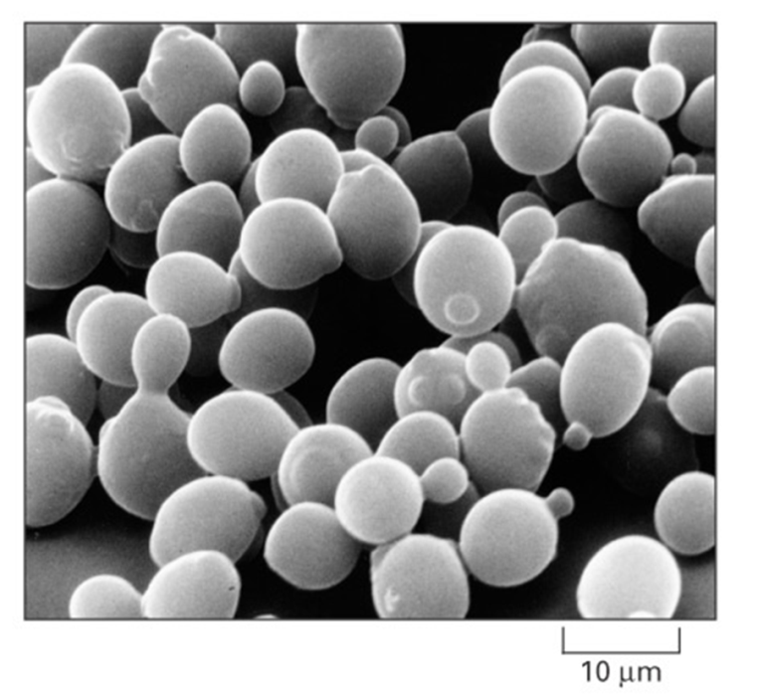
Saccharomyces cerevisiae is an Ideal Model Organism for Systems Biology
Budding yeast is used as a model organism due to its small genome size of approximately 6000 genes.
These 6000 genes are regulated by ~250 transcription factors, which can increase or decrease gene expression.
Yeast deletion strains and other molecular genetic tools are readily available.
For example, we have gained important information about cancer from studying yeast.
Notes:
Make titles a smaller font
Separate each three point into separate slides.
This is a general audience so we need to separate these three points.
Add pictures to each slide
Explain the rationale for a cold shock
Add to research questions: 1. what transcription factors regulate cold shock response 2. What is the indirect effect? – there isn’t a master controller but a group working together that may influence each other 3. understanding the network – can we make predictions into what might happen in a future experiment
Yeast
Cold Shock
GRN
Need reference for Alberts et al 2004
Combi

Slide 5
The Response to the Environmental Stress Cold Shock Is Not Well Studied
Cold shock for yeast is from 10-18℃.
The response is not as well characterized as heat shock.
Heat Shock | Cold Shock
Proteins denature | Decrease fluidity of membranes
Induction of heat shock proteins that assist in protein folding | Stabilizes DNA and RNA secondary structures
Conserved in all organisms | Impair ribosome function and protein synthesis
 | Decreased Enzymatic activities
 | No equivalent set of cold shock proteins that are conserved in all organisms
Notes:
Make titles a smaller font
Separate each three point into separate slides.
This is a general audience so we need to separate these three points.
Add pictures to each slide
Explain the rationale for a cold shock
Add to research questions: 1. what transcription factors regulate cold shock response 2. What is the indirect effect? – there isn’t a master controller but a group working together that may influence each other 3. understanding the network – can we make predictions into what might happen in a future experiment
Yeast
Cold Shock
GRN
Practice saying this (chaperonin not chaperone)

Slide 6
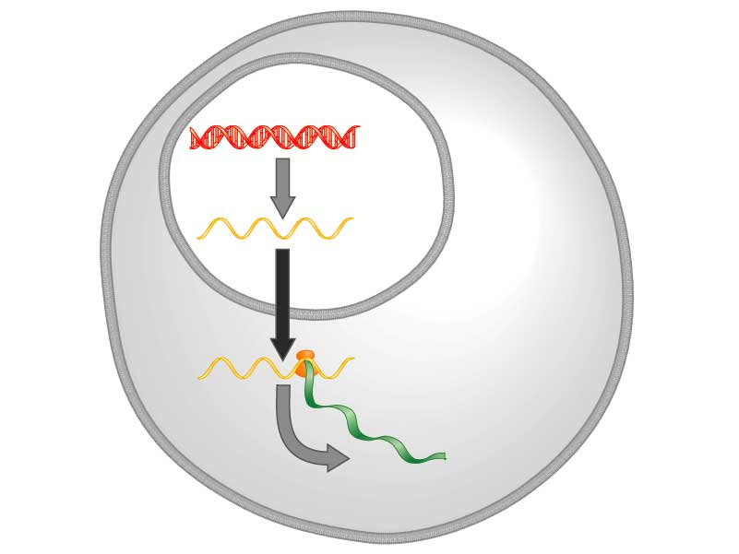
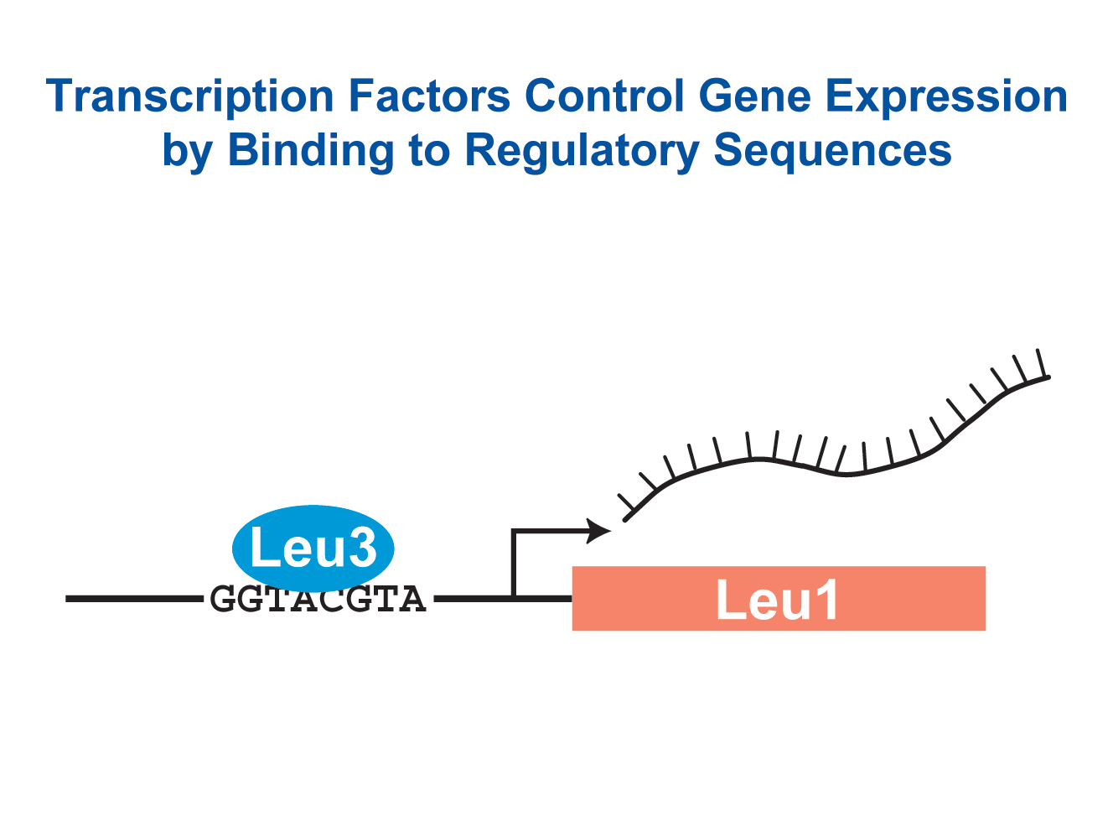
Yeast respond to cold shock by changing the level of gene expression
Transcription factors control gene expression by binding to regulatory DNA sequences.
Activators increase expression and repressors decrease expression
Transcription factors are themselves proteins encoded by genes.
A gene regulatory network (GRN) is a set of transcription factors that regulate the expression of genes encoding other transcription factors.
DNA
Transcription
mRNA
Translation
Protein
Notes:
Make titles a smaller font
Separate each three point into separate slides.
This is a general audience so we need to separate these three points.
Add pictures to each slide
Explain the rationale for a cold shock
Add to research questions: 1. what transcription factors regulate cold shock response 2. What is the indirect effect? – there isn’t a master controller but a group working together that may influence each other 3. understanding the network – can we make predictions into what might happen in a future experiment
Yeast
Cold Shock
GRN
Reference Freeman 2002

Slide 7
Yeast respond to cold shock by changing the level of gene expression
DNA
1. Which transcription factors regulate the cold shock response in yeast?
2. What is the indirect effect of other transcription factors?
3. Can we make predictions based on our understanding of the network?
Transcription
mRNA
Translation
Protein
Notes:
Make titles a smaller font
Separate each three point into separate slides.
This is a general audience so we need to separate these three points.
Add pictures to each slide
Explain the rationale for a cold shock
Add to research questions: 1. what transcription factors regulate cold shock response 2. What is the indirect effect? – there isn’t a master controller but a group working together that may influence each other 3. understanding the network – can we make predictions into what might happen in a future experiment
Yeast
Cold Shock
GRN

Slide 8
A Family of Networks for theΔgln3 Deletion Strain Was Compared to Investigate the Cold Shock Response of Yeast
Yeast Respond to Cold Shock by Changing Gene Expression.
Microarray Data was Generated for Yeast Under Cold Shock Conditions.
A Family of Related Networks Was Generated from the YEASTRACT Database.
The Dynamics of Each Gene in the Network was Modeled Using Ordinary Differential Equations.
L-curve Analysis Was Performed to Determine the Best α.
The Family of Related Network Were Compared to Determine Which Size Network Models the Experimental Data Best.

Slide 9
The Dahlquist Lab Utilizes a Systems Biology Work Flow to Investigate the Cold Shock Response In Yeast
Generate Microarray Data
Perform Statistical Analysis
Generate Gene a Regulatory Network
Model Dynamics of the System
New Experimental Questions
Visualize the Results
Notes:
Make text bigger

Slide 10
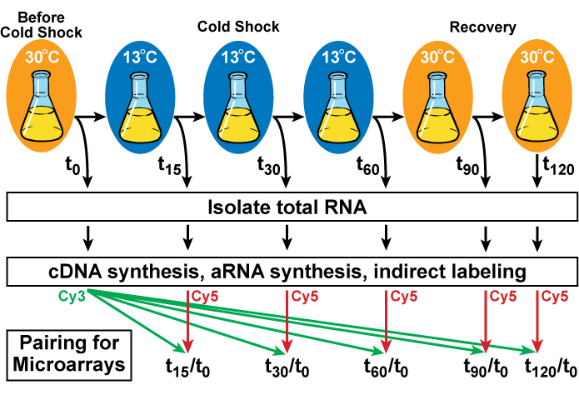
Yeast Cells with Particular Transcription Factors Deleted are Harvested Before, During, and After Cold Shock
Notes:
What is cold shock doing in lab
Provide more context
Explain where data came from
Emphasize that this is the input data for the model
Third bullet point
Why we deleted certain genes
Explain which deletion strain I’m using, why I’m focusing on it
Use as opportunity to say GLN3 go see my team members’ posters
Mention that we are only modeling the cold shock phase

Slide 11
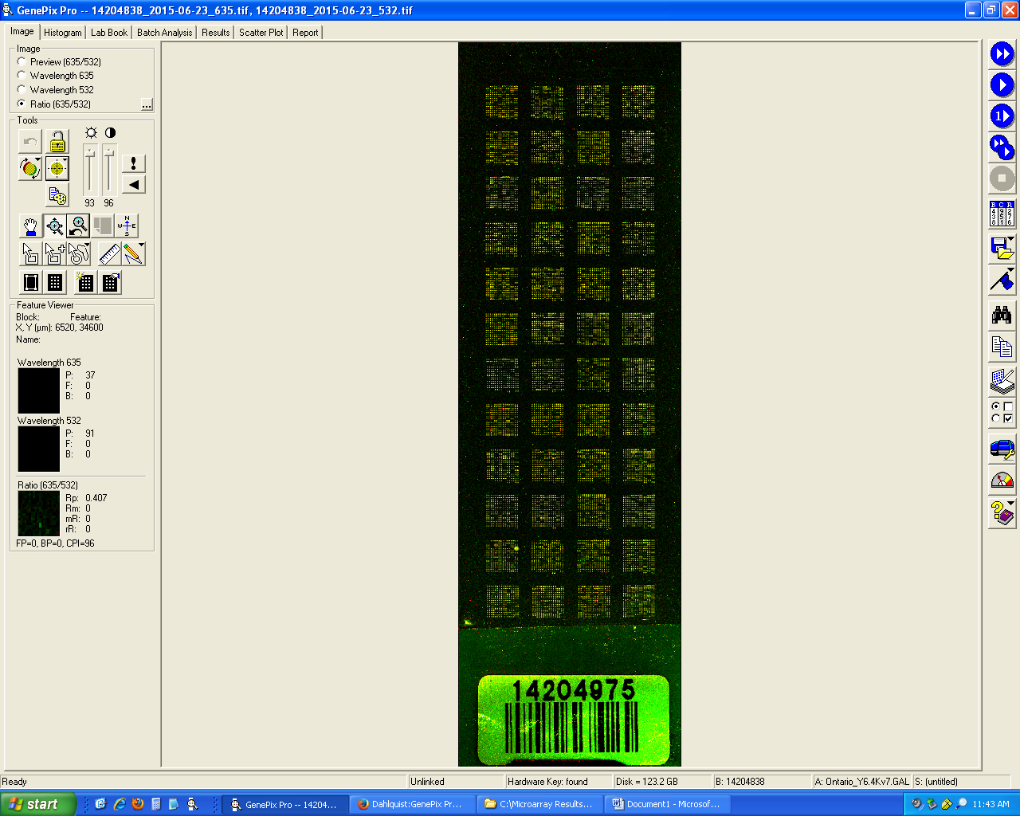
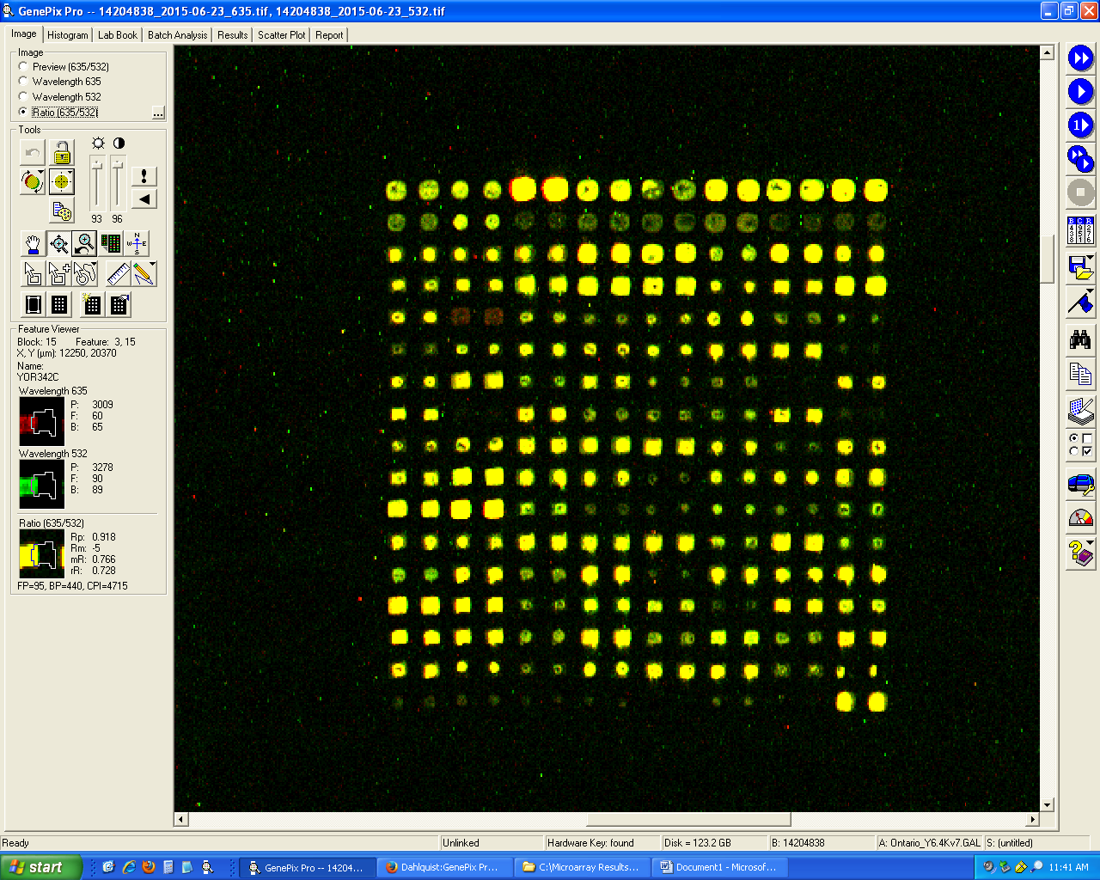
Microarray Data is Used to Observe Changes in Gene Expression for All 6000 Genes in Yeast
Each spot contains DNA from one gene.
For each Spot:
Increase Expression
Decrease Expression
No Change in Expression
DNA microarray experiments were performed for the wild type and five transcription factor deletion strains.
For my analysis I focused on the gln3 deletion strain.
A strain deleted for gln3 has impaired growth at cold temperatures, so we felt it would be a key gene in the network.
Sample Microarray Slide from the Dahlquist Lab
Notes:
What is cold shock doing in lab
Provide more context
Explain where data came from
Emphasize that this is the input data for the model
Third bullet point
Why we deleted certain genes
Explain which deletion strain I’m using, why I’m focusing on it
Use as opportunity to say GLN3 go see my team members’ posters
Add back in deletion strains

Slide 12
A Family of Networks for theΔgln3 Deletion Strain Was Compared to Investigate the Cold Shock Response of Yeast
Yeast Respond to Cold Shock by Changing Gene Expression.
Microarray Data was Generated for Yeast Under Cold Shock Conditions.
A Family of Related Networks Was Generated from the YEASTRACT Database.
The Dynamics of Each Gene in the Network was Modeled Using Ordinary Differential Equations.
L-curve Analysis Was Performed to Determine the Best α.
The Family of Related Network Were Compared to Determine Which Size Network Models the Experimental Data Best.

Slide 13
The Δgln3 Strain Microarray Data Was Used to Derive a Family of Related GRNs from the YEASTRACT Database
Indicates which genes had significant changes in expression at any time point
YEASTRACT Database
These genes were submitted to the YEASTRACT database, which returned a list of candidate regulatory transcription factors that potentially regulate those target genes, in order of significance.
Within-strain ANOVA
Generate “Family” of Related Networks
Notes:
Change title

Slide 14
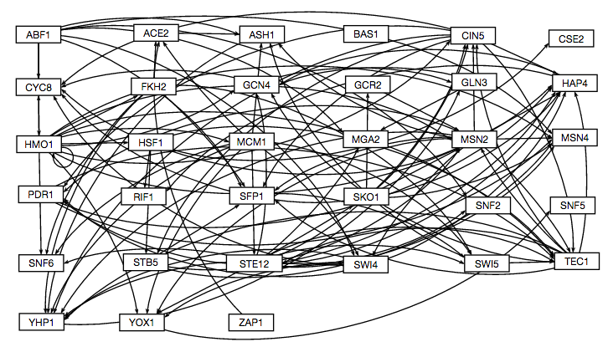
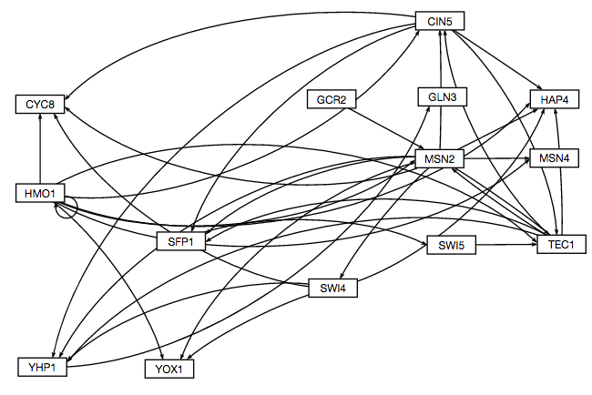
A “Family” of Related Networks Was Created by Paring Down Genes and Edges from the Largest Network
We started with a network of 29 genes made up of the most significant regulators.
The transcription factors for which we had deletion strain microarray data were added to the list of the 29 most significant regulators to generate the largest GRN we modeled with a total of 32 genes and 110 edges.
Transcription factors and edges were removed from the GRN in a stepwise fashion in order of least to most significant until the network was pared down to 14 genes and 35 edges.
We then ran the model on networks with 32, 29, 20, and 14 genes.
32 gene 110 edge network
14 gene 35 edge network
Notes:
Explain in terms of family of networks that it is a family of related networks
The reason we are doing that is because we want to know what size network best explains the data
Add number of edges
Emphasis on what the connections mean (regulation)
What we’re trying to figure out is whether it’s activation or repression and how strong it is
Could blow the network up to the size of the slide and say the stuff on the slides and click through as you say all the bullet points

Slide 15
A Family of Networks for theΔgln3 Deletion Strain Was Compared to Investigate the Cold Shock Response of Yeast
Yeast Respond to Cold Shock by Changing Gene Expression.
Microarray Data was Generated for Yeast Under Cold Shock Conditions.
A Family of Related Networks Was Generated from the YEASTRACT Database.
The Dynamics of Each Gene in the Network was Modeled Using Ordinary Differential Equations.
L-curve Analysis Was Performed to Determine the Best α.
The Family of Related Network Were Compared to Determine Which Size Network Models the Experimental Data Best.

Slide 16
GRNmap Uses Ordinary Differential Equations to Model the Dynamics of Each Gene in the Network
The MATLAB code and executable are available under an open source license at
https://github.com/kdahlquist/GRNmap/.
The expression levels of the individual transcription factors were modeled using mass balance ordinary differential equations with a sigmoidal production function.

Slide 17
GRNmap Uses Ordinary Differential Equations to Model the Dynamics of Each Gene in the Network
The MATLAB code and executable are available under an open source license at
https://github.com/kdahlquist/GRNmap/.
The expression levels of the individual transcription factors were modeled using mass balance ordinary differential equations with a sigmoidal production function.
Protein degradation rate for gene i

Slide 18
GRNmap Uses Ordinary Differential Equations to Model the Dynamics of Each Gene in the Network
The MATLAB code and executable are available under an open source license at
https://github.com/kdahlquist/GRNmap/.
The expression levels of the individual transcription factors were modeled using mass balance ordinary differential equations with a sigmoidal production function.
mRNA production rate for gene i

Slide 19
GRNmap Uses Ordinary Differential Equations to Model the Dynamics of Each Gene in the Network
The MATLAB code and executable are available under an open source license at
https://github.com/kdahlquist/GRNmap/.
The expression levels of the individual transcription factors were modeled using mass balance ordinary differential equations with a sigmoidal production function.
weight term
determines the level of activation or
repression of gene j on gene i

Slide 20
GRNmap Uses Ordinary Differential Equations to Model the Dynamics of Each Gene in the Network
The MATLAB code and executable are available under an open source license at
https://github.com/kdahlquist/GRNmap/.
The expression levels of the individual transcription factors were modeled using mass balance ordinary differential equations with a sigmoidal production function.
Unique threshold for each gene
Notes:
Threshold for the log fold change. Indicates whether a gene is upregulated or downregulated.

Slide 21
A Family of Networks for theΔgln3 Deletion Strain Was Compared to Investigate the Cold Shock Response of Yeast
Yeast Respond to Cold Shock by Changing Gene Expression.
Microarray Data was Generated for Yeast Under Cold Shock Conditions.
A Family of Related Networks Was Generated from the YEASTRACT Database.
The Dynamics of Each Gene in the Network was Modeled Using Ordinary Differential Equations.
L-curve Analysis Was Performed to Determine the Best α.
The Family of Related Network Were Compared to Determine Which Size Network Models the Experimental Data Best.

Slide 22
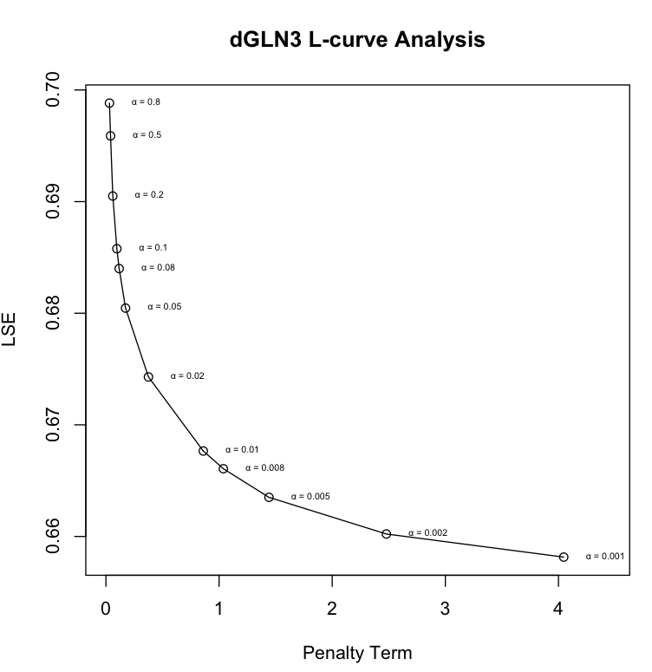
A Penalized Least Squares Approach is Used to Estimate Parameters
Penalty Term: combined production rate, weight, and threshold parameters
Plotting the least squares error function showed that not all the graphs had clear minima.
We added alpha and the penalty term to force the function to minimize on a single solution
We performed an L-curve analysis to determine the best value to use for alpha.
L-curve for the Smallest Network
Notes:
Alpha that is flexible enough to get the dynamics, but restrains the dynamics so that it makes sense biologically
Plotting the least squares error function showed that not all the graphs had clear minima.
We added a penalty term so that MATLAB’s optimization algorithm would be able to minimize the function.
θ is the combined production rate, weight, and threshold parameters.
α is determined empirically from the “elbow” of the L-curve.
Penalty term – many possible solutions so we use the penalty term to
Arrow to 0.002

Slide 23
A Penalized Least Squares Approach is Used to Estimate Parameters
Theoretical
We performed an L-curve analysis to determine the best value to use for alpha.
Plotting the least squares error function showed that not all the graphs had clear minima.
Among the GRNmap data analysis team, it was decided that we would use α=0.002.
Experimental
L-curve for the Smallest Network Family
Notes:
Alpha that is flexible enough to get the dynamics, but restrains the dynamics so that it makes sense biologically
Plotting the least squares error function showed that not all the graphs had clear minima.
We added a penalty term so that MATLAB’s optimization algorithm would be able to minimize the function.
θ is the combined production rate, weight, and threshold parameters.
α is determined empirically from the “elbow” of the L-curve.

Slide 24
A Penalized Least Squares Approach is Used to Estimate Parameters
α: determined empirically from the “elbow” of the curve
We performed an L-curve analysis to determine the best value to use for alpha.
Plotting the least squares error function showed that not all the graphs had clear minima.
Among the GRNmap data analysis team, it was decided that we would use α=0.002.
L-curve for the Smallest Network Family
Notes:
Alpha that is flexible enough to get the dynamics, but restrains the dynamics so that it makes sense biologically
Plotting the least squares error function showed that not all the graphs had clear minima.
We added a penalty term so that MATLAB’s optimization algorithm would be able to minimize the function.
θ is the combined production rate, weight, and threshold parameters.
α is determined empirically from the “elbow” of the L-curve.

Slide 25
A Family of Networks for theΔgln3 Deletion Strain Was Compared to Investigate the Cold Shock Response of Yeast
Yeast Respond to Cold Shock by Changing Gene Expression.
Microarray Data was Generated for Yeast Under Cold Shock Conditions.
A Family of Related Networks Was Generated from the YEASTRACT Database.
The Dynamics of Each Gene in the Network was Modeled Using Ordinary Differential Equations.
L-curve Analysis Was Performed to Determine the Best α.
The Family of Related Network Were Compared to Determine Which Size Network Models the Experimental Data Best.

Slide 26
Production Rate for Each Gene Remains Fairly Constant for All Network Sizes
Notes:
Production rate look at MSN2 difference between 33 and 29
Might want to present bar charts first
Make this slide 16

Slide 27
The Threshold b Parameter Changes Sign for Key Genes in the Network
Notes:
Estimated Threshold b look at SNF2 difference between 33 and 29

Slide 28
Weight Parameter Changes Sign for Key Genes in the Network
Notes:
CIN5->TEC1 0.39949931 0.332280944 -0.25026136 -0.41176991 -0.55644359
HAP4->MSN2 1.751453531 1.099593686 -2.6278961 -2.82844126 -2.48398188

Slide 29
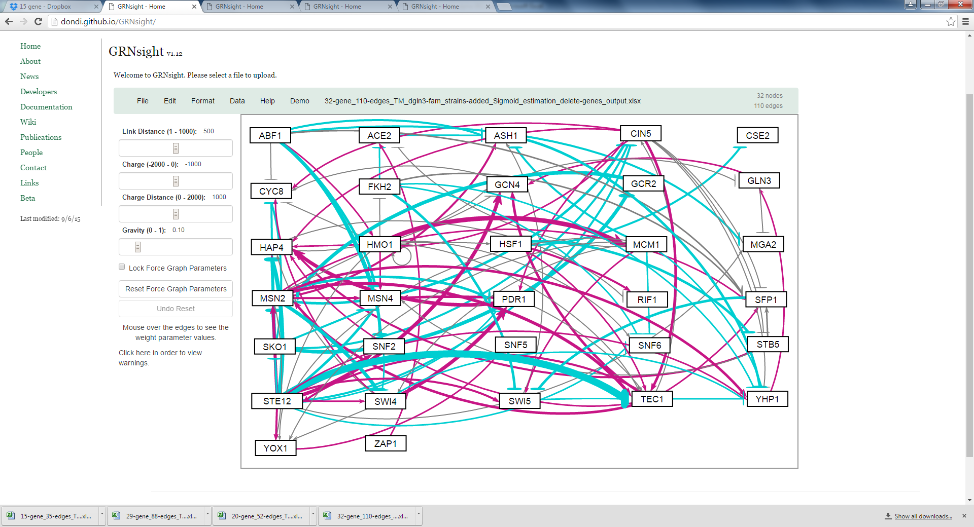
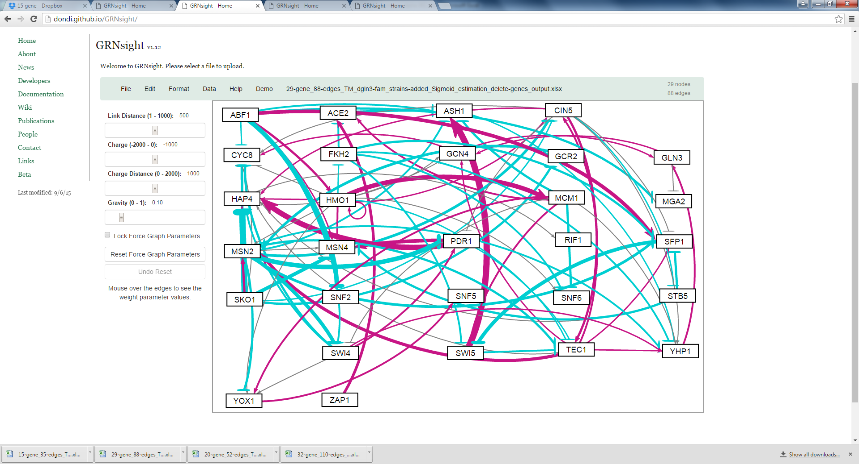
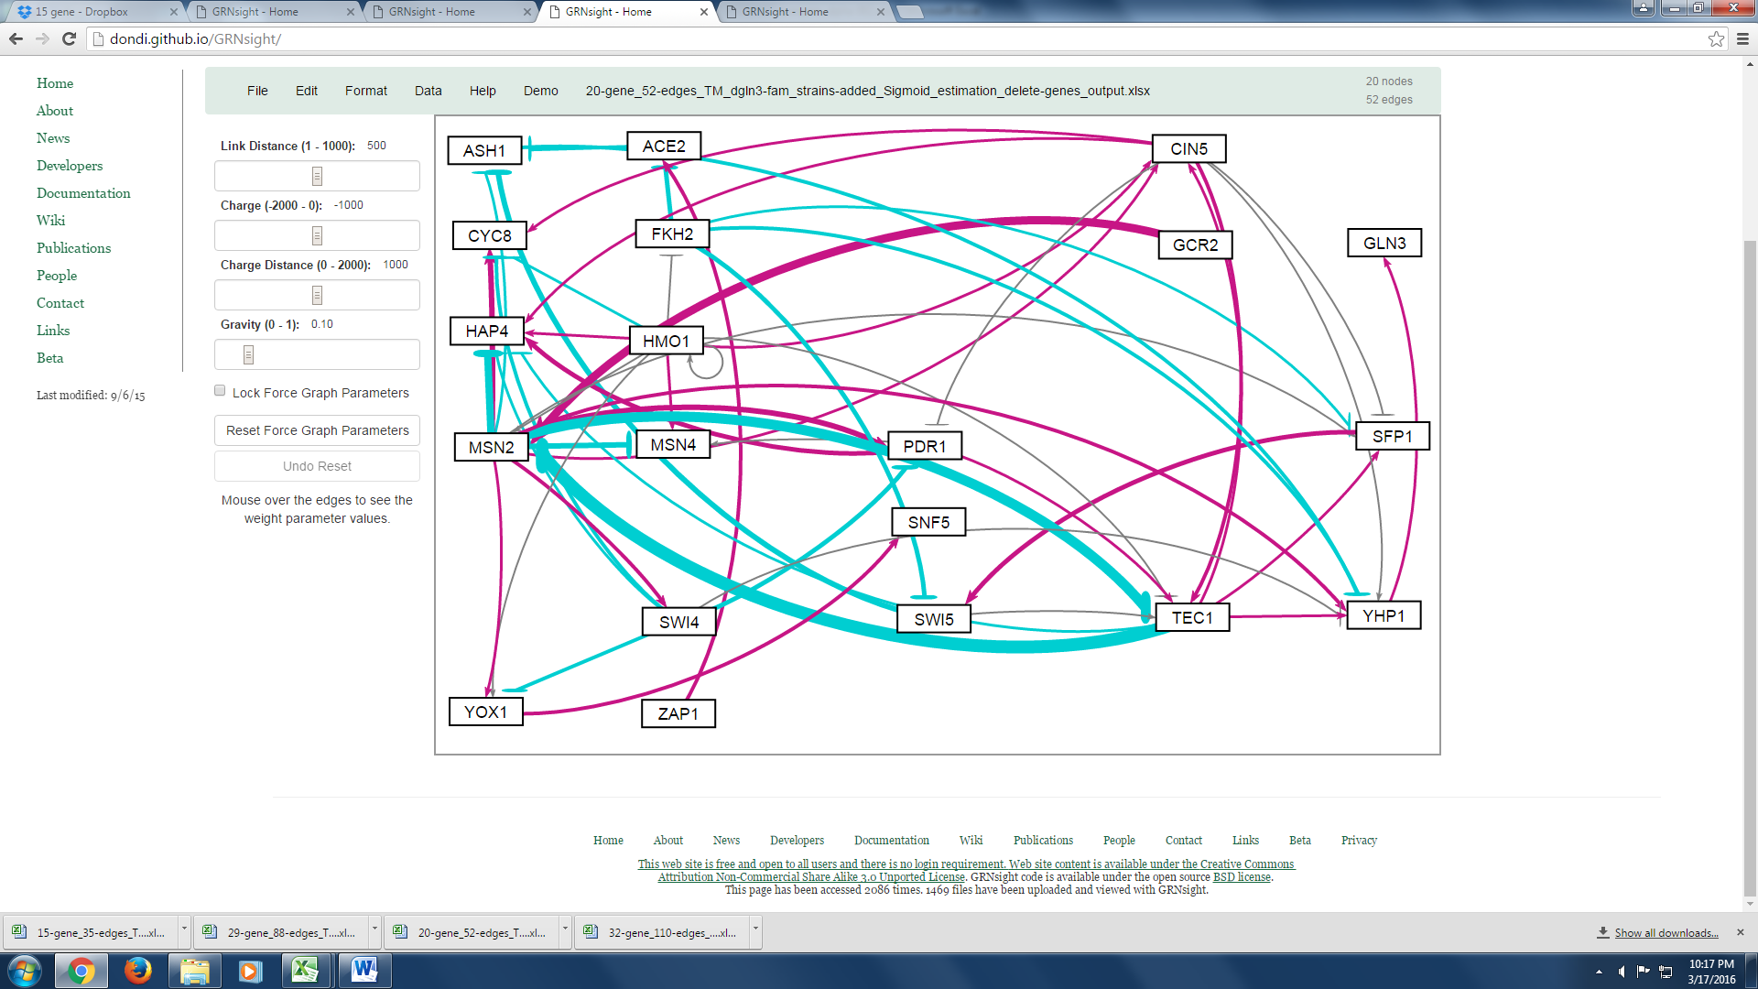
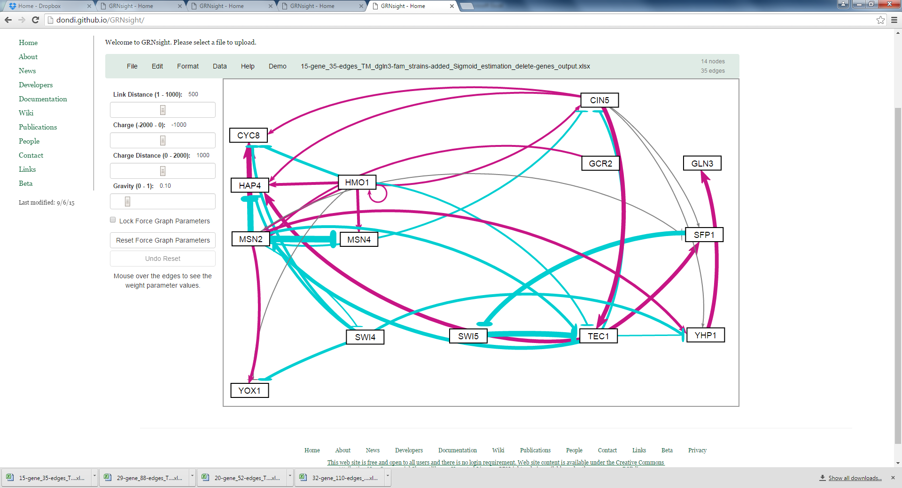
GRNsight Facilitates Visualization of Optimized Weight Parameters
32 gene 110 edges
29 gene 88 edges
20 gene 52 edges
14 gene 35 edges
Notes:
Talk about why it is colored. (Activation vs. repression)
Talk about how the weights change. (thickness)
Observations about why things are changing
Focus more on this ***
Explain example of MSN2 -> MSN4 to point to it and explain it
Delete “weighted network”

Slide 30
Comparison Between Minimum Theoretical LSE and LSE for the “Family” of Networks
Network Size | LSE | Minimum Theoretical LSE | Ratio (LSE / min LSE)
14 | 0.7311 | 0.5378 | 1.3596
20 | 0.7206 | 0.5177 | 1.3920
29 | 0.7680 | 0.5534 | 1.3877
32 | 0.7313 | 0.5353 | 1.3660
The LSE is a measure of how well the data is modeled.
It was expected that the LSE would increase as the size of the network increases, however the network with the largest LSE was the 29 gene network.
The network with the smallest LSE and minimum theoretical LSE was the 20 gene network.
The ratio of LSE and min LSE shows that the model performs similarly for the family of networks.
Notes:
There is a peak at the 24 node network, which does not go with intuition.
Ratio of min LSE to LSE is all close to 1.4, but not sure whether that is the conclusion we should draw of th
Not sure what this means
At least say in words what LSE is

Slide 31
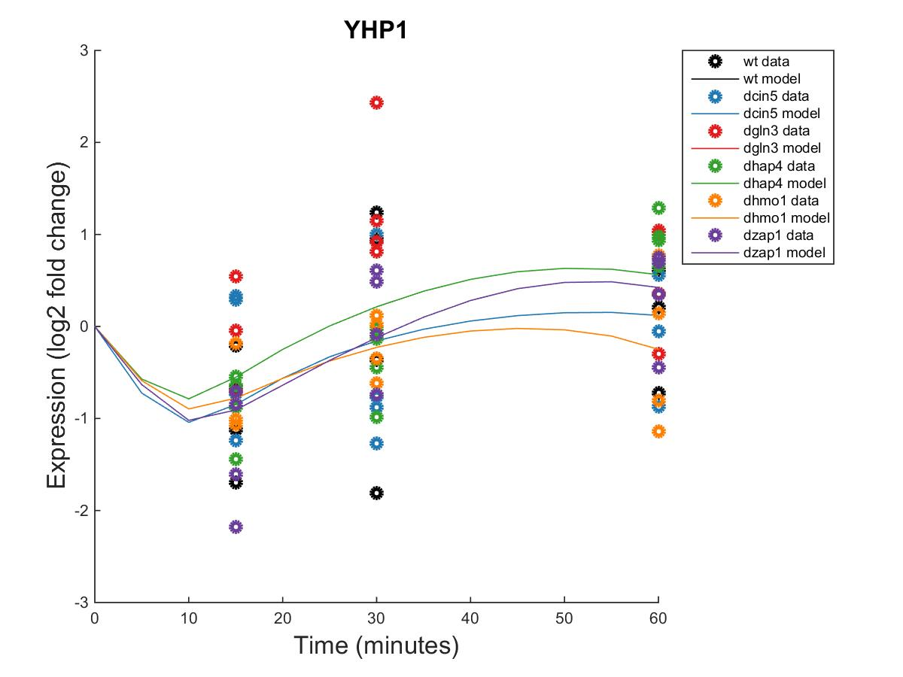
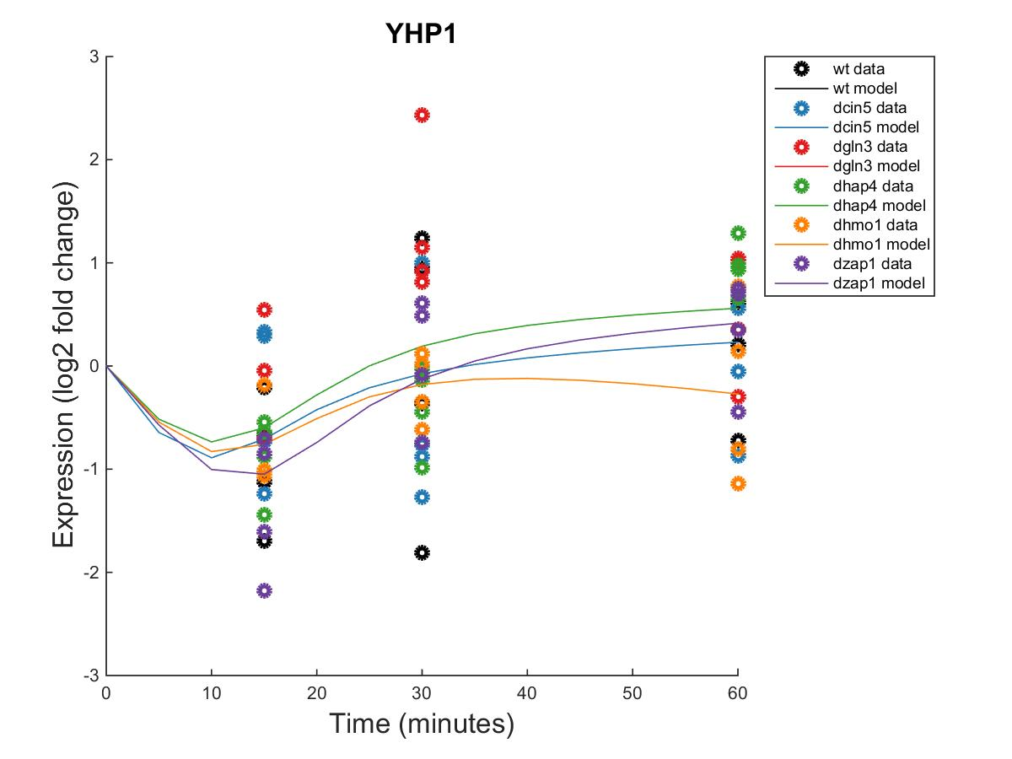
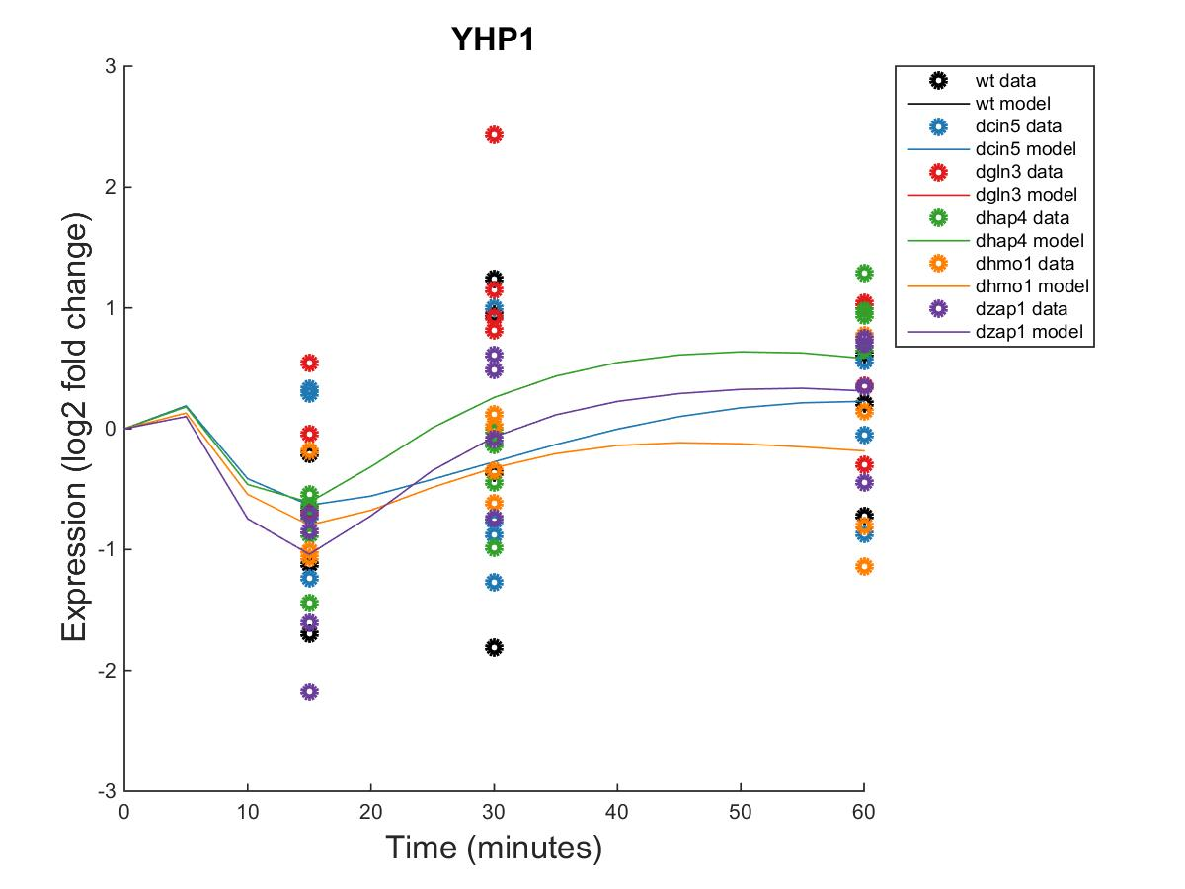
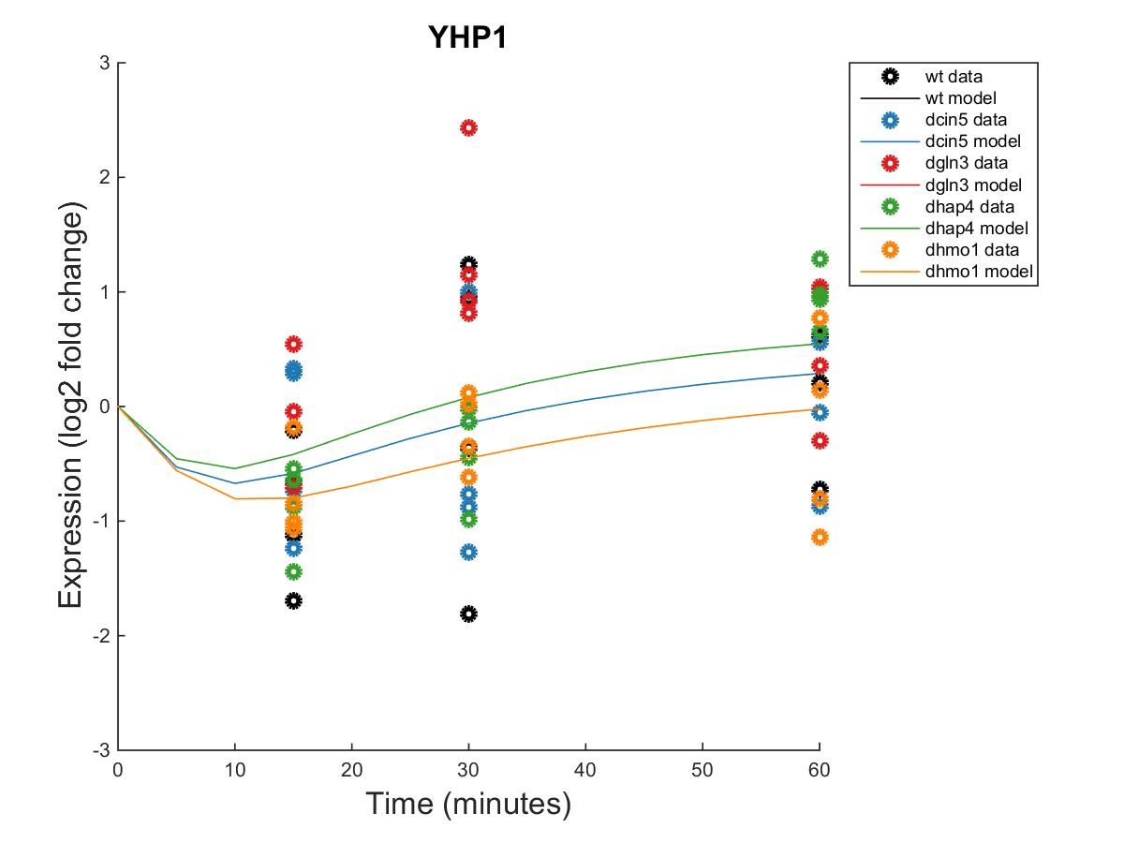
YHP1 Is Modeled Best by the 29 and 20 gene Networks
32 gene 110 edges
29 gene 88 edges
20 gene 52 edges
14 gene 35 edges
Network Size | Sum MSE
14 | 2.9446
20 | 3.2249
29 | 3.2738
32 | 3.1622
ANOVA p-value | 0.0330
Notes:
Blow up plots / change titles
MSE
Dots are experimental data
Lines are theoretical data

Slide 32
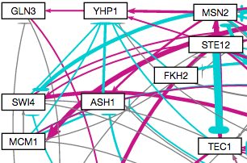
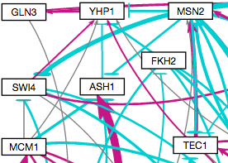
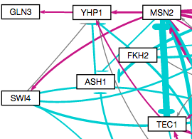
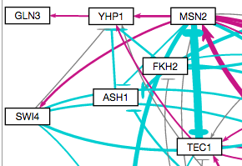
YHP1 Is Modeled Best by the 29 and 20 gene Networks
32 gene 110 edges
29 gene 88 edges
20 gene 52 edges
14 gene 35 edges
Notes:
Point at things / laser

Slide 33
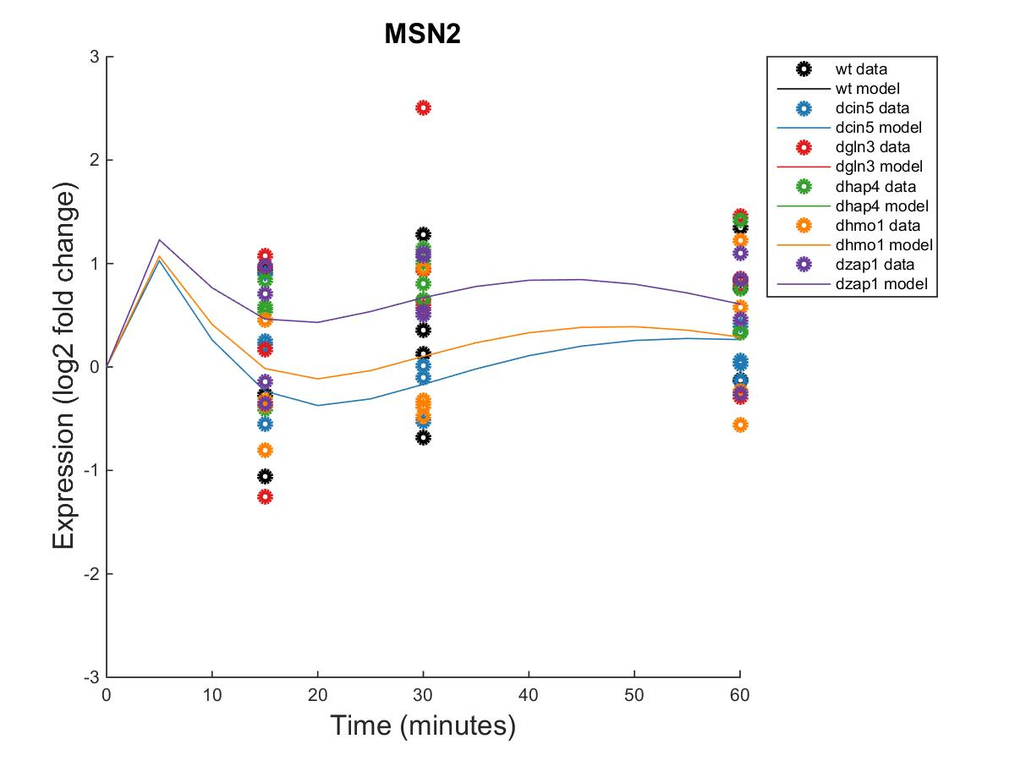
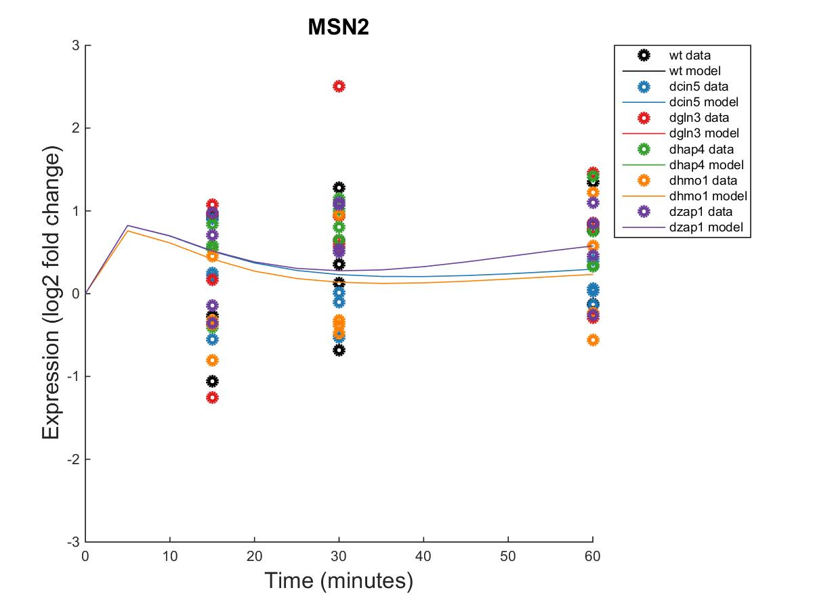
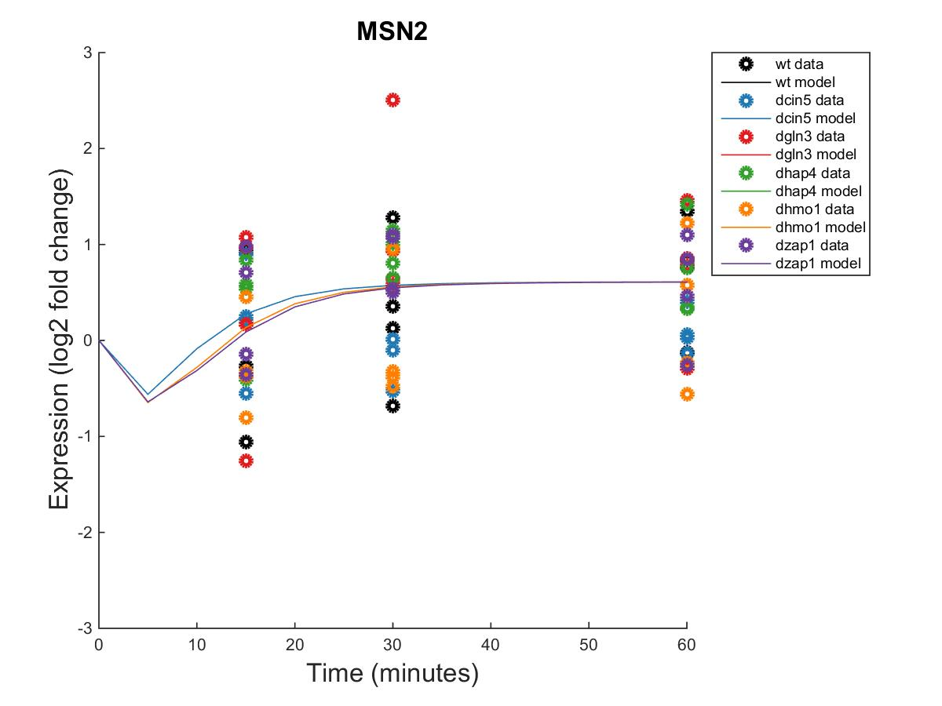
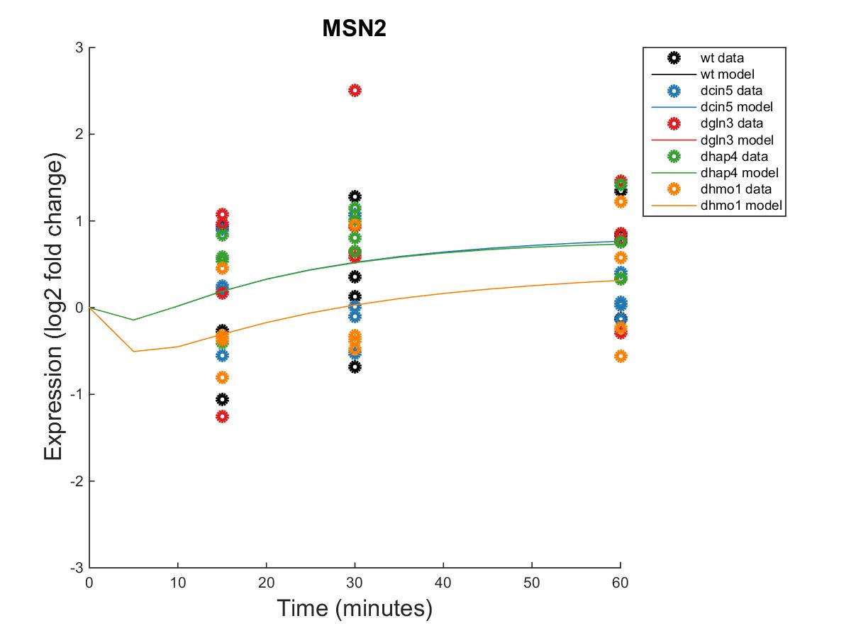
Transcription Factor MSN2 Changes Its Dynamics for the Different Families of Related Networks
32 gene 110 edges
29 gene 88 edges
20 gene 52 edges
14 gene 35 edges
Network Size | Sum MSE
14 | 2.2065
20 | 2.6366
29 | 2.8613
32 | 2.3691
ANOVA p-value | 0.2550

Slide 34
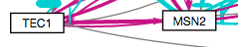
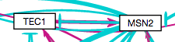
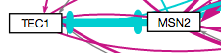
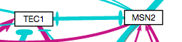
Transcription Factor MSN2 Changes Its Dynamics for the Different Families of Related Networks
32 gene 110 edges
29 gene 88 edges
20 gene 52 edges
14 gene 35 edges

Slide 35
We Successfully Modeled a Family of Four Networks Using GRNmap
DNA
Which transcription factors regulate the cold shock response in yeast?
YHP1 and MSN2 play key roles in the network
The effect of GLN3 may be because of its regulation by YHP1
What is the indirect effect of other transcription factors?
The 20 gene network best accounts for indirect effects of other regulatory transcription factors upon cold shock gene expression.
Deleting nodes and edges from the network affected the parameters, suggesting indirect effects are important
Can we make predictions based on our understanding ofthe network?
The wet lab team is now studying the effects of ASH1
Transcription
mRNA
Translation
Protein
Notes:
Make titles a smaller font
Separate each three point into separate slides.
This is a general audience so we need to separate these three points.
Add pictures to each slide
Explain the rationale for a cold shock
Add to research questions: 1. what transcription factors regulate cold shock response 2. What is the indirect effect? – there isn’t a master controller but a group working together that may influence each other 3. understanding the network – can we make predictions into what might happen in a future experiment
Yeast
Cold Shock
GRN

Slide 36
Acknowledgements
GRNmap data analysis team: Kristen M. Horstmann, K. Grace Johnson, Brandon Klein, Margaret J. O’Neil
GRNmap coding team: Juan S. Carrillo, Trixie A. Roque, Nicholas A. Rohacz, Katrina Sherbina, and
Chukwuemeka Azinge
GRNsight team: Nicole A. Anguiano, Anindita Varshneya, and Mihir Samdarshi
Wet-lab team: Cybele Arsan, Wesley Citti, Kevin Entzminger, Andrew Herman, Monica Hong, Heather King, Lauren Kubeck, Stephanie Kuelbs, Elizabeth Liu, Matthew Mejia, Kevin McGee, Kenny Rodriguez, Olivia Sakhon, Alondra Vega, and Kevin Wyllie.
Mentors: Dr. Kam Dahlquist and Dr. Ben Fitzpatrick

Slide 37
References
Belle, A., Tanay, A., Bitincka, L., Shamir, R., & O’Shea, E. K. (2006). Quantification of protein half-lives in the budding yeast proteome.Proceedings of the National Academy of Sciences, 103(35), 13004-13009.
Dahlquist, K., Fitzpatrick, B., Camacho, E., Entzminger, S., & Wanner, N. (2015). Parameter Estimation for Gene Regulatory Networks from Microarray Data: Cold Shock Response in Saccharomyces cerevisiae. Bulletin Of Mathematical Biology, 77(8), 1457-1492. http://dx.doi.org/10.1007/s11538-015-0092-6.
Dário Abdulrehman, Pedro T. Monteiro, Miguel C. Teixeira, Nuno P. Mira, Artur B. Lourenço, Sandra C. dos Santos, Tânia R. Cabrito, Alexandre P. Francisco, Sara C. Madeira, Ricardo S. Aires, Arlindo L. Oliveira, Isabel Sá-Correia, Ana T. Freitas (2011). YEASTRACT: providing a programmatic access to curated transcriptional regulatory associations in Saccharomyces cerevisiae through a web services interface Nucl. Acids Res., 39: D136-D140, Oxford University Press.
Freeman, S. (2002). Biological science. Upper Saddle River, NJ: Prentice Hall.
GRNsightt. (n.d.). Retrieved March 10, 2016, from http://dondi.github.io/GRNsight/
GRNmap. (n.d.). Retrieved March 10, 2016, from https://github.com/kdahlquist/GRNmap

